Slide 1


SMART FARM
Team: Goodbye, world.
Members:
Beka
Alish
Ilyas

Slide 2
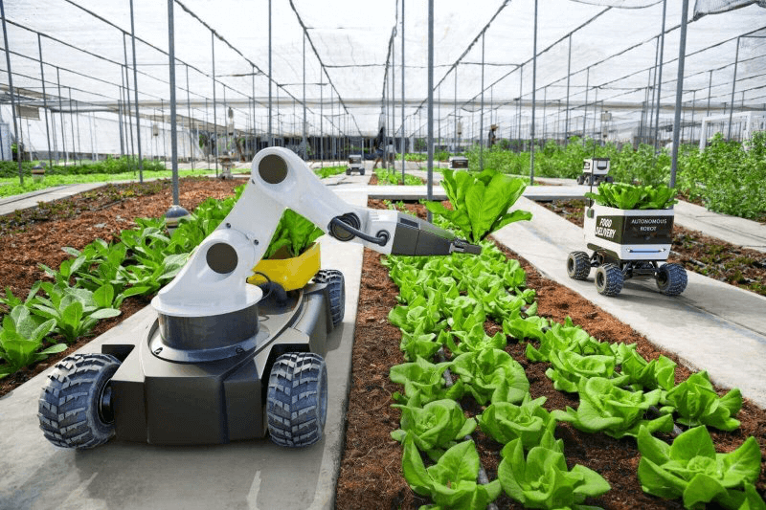
Definition:
Smart farming is a strategy aimed at equipping the agricultural sector with the necessary tools and resources to utilize cutting-edge technology effectively.

Slide 3
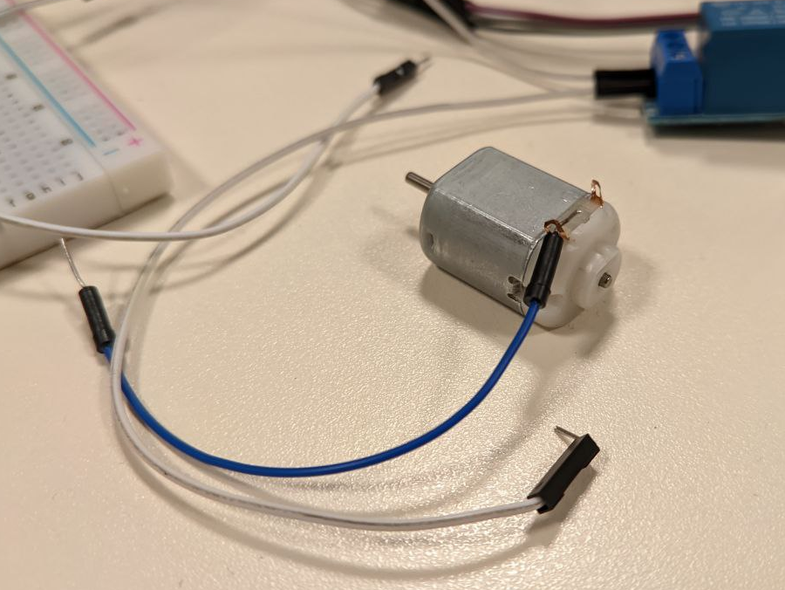
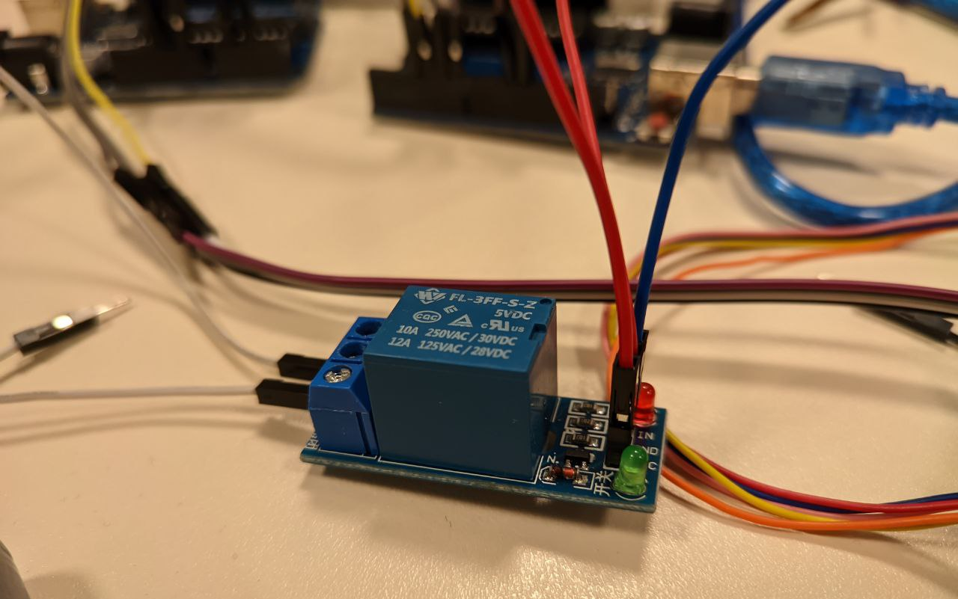
1. Plant caring subsystem:
Motor: performs functions of a pump
Switch controller

Slide 4
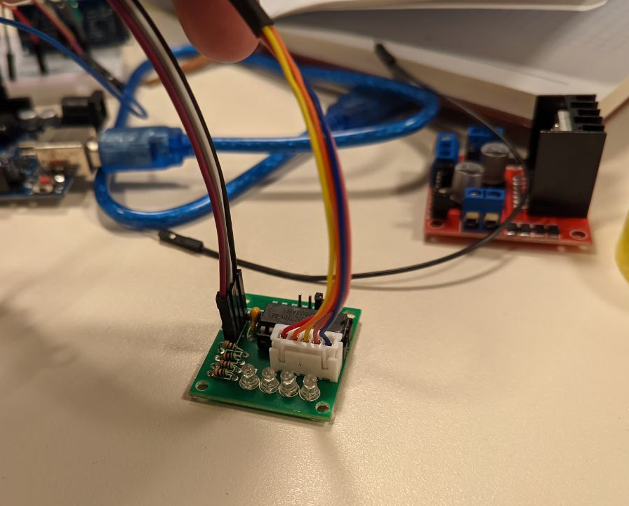
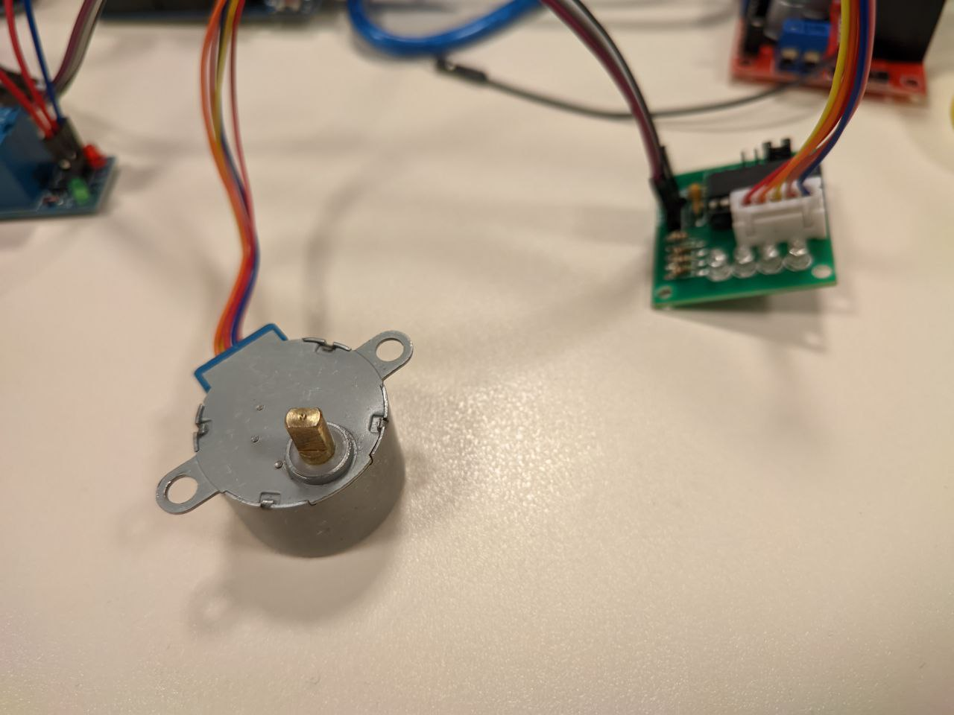
2. Cattle and animal caring subsystem:
Motor Driver
Stepper Motor

Slide 5
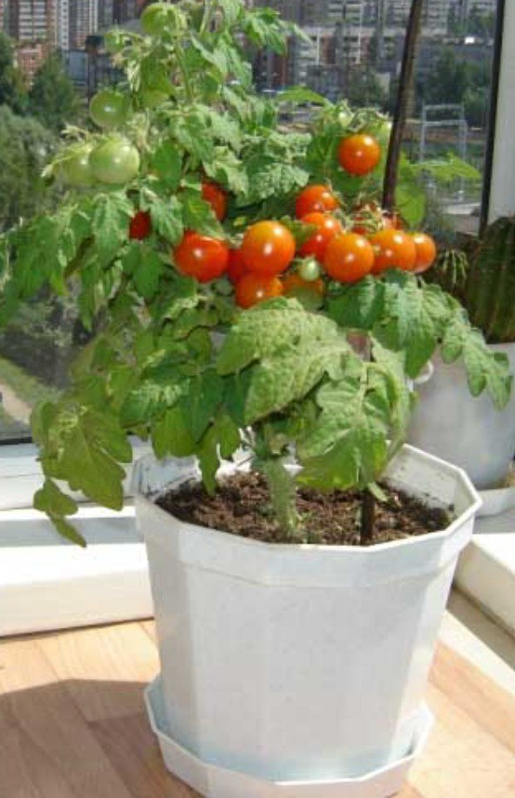
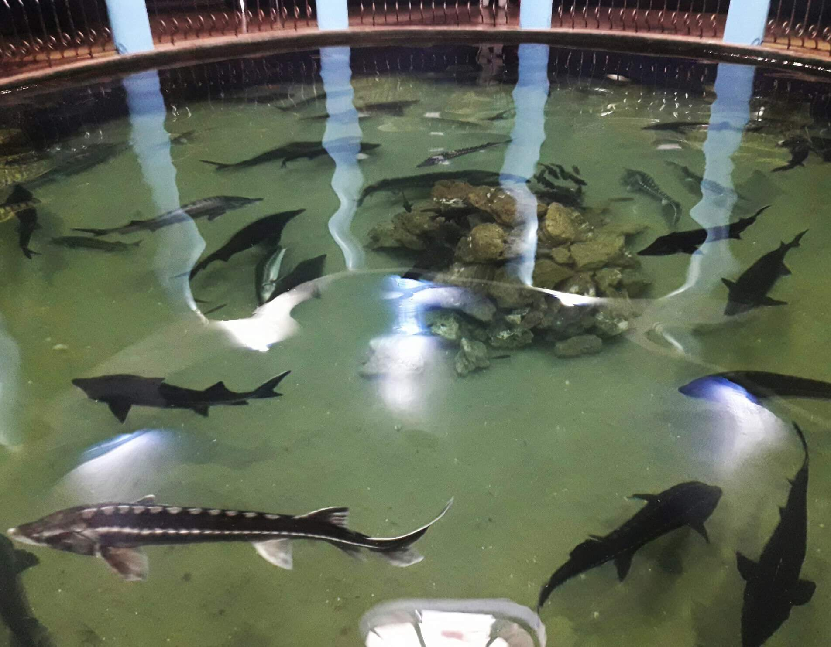
3. Example plant and fish:
Plant: Tomato bush
Example of fish enterpraise

Slide 6
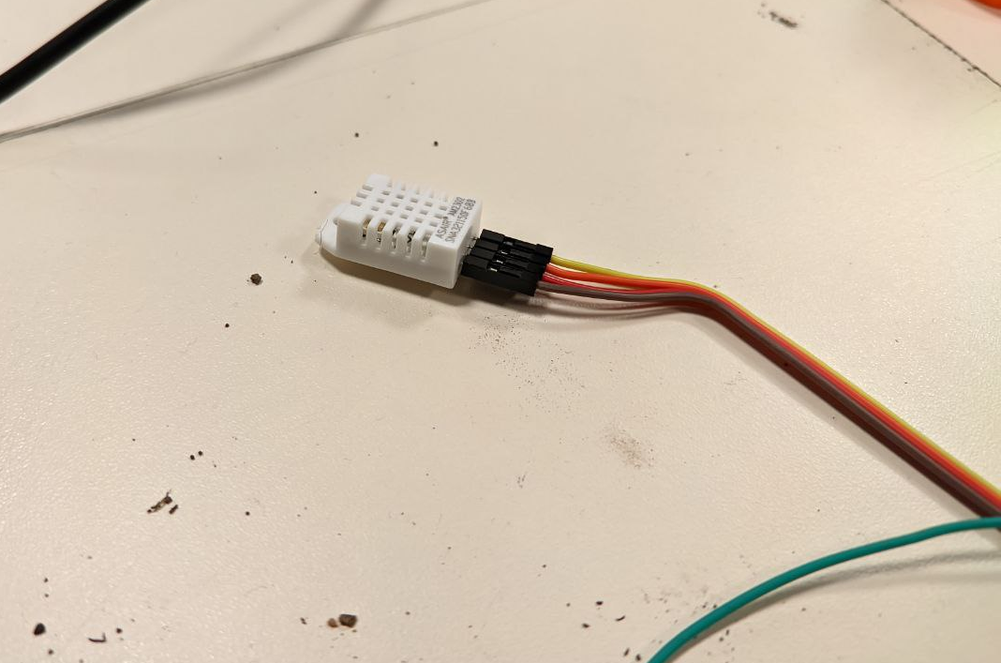
4. Monitoring of climate conditions
Apparatus monitor:
Temperature
Humidity
HTF-22 Sensor

Slide 7
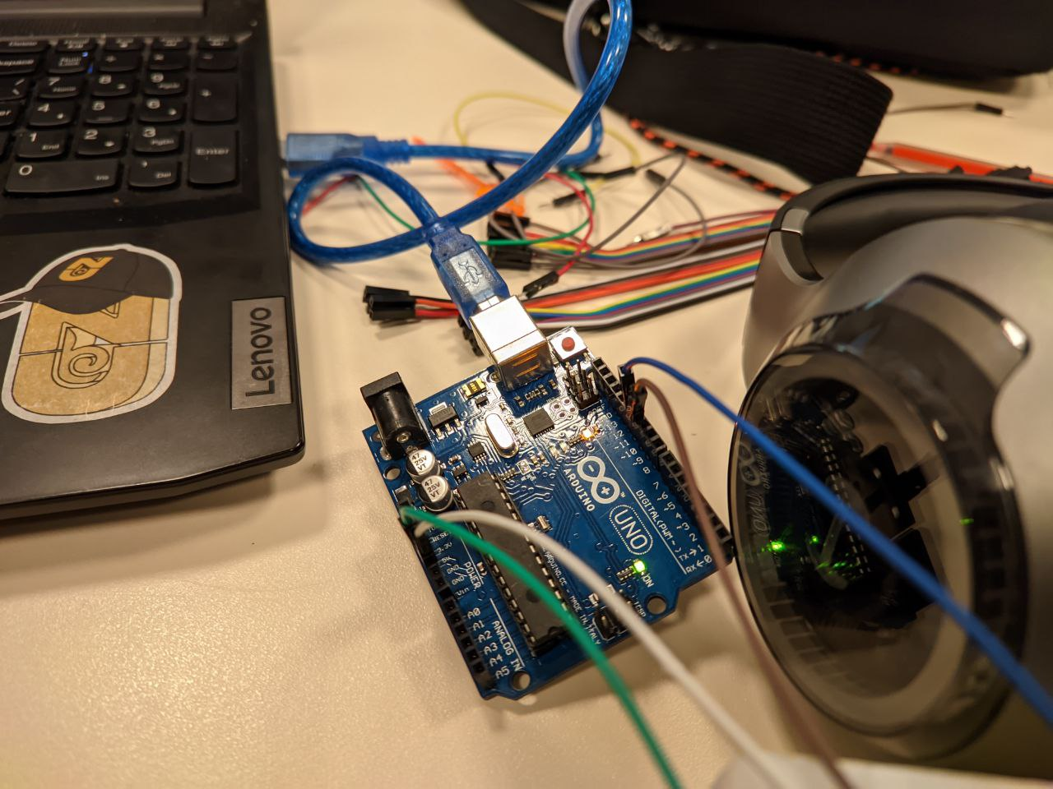
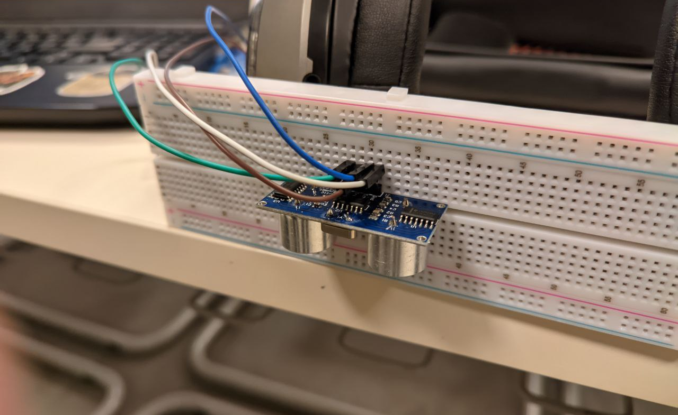
5. Crop management subsystem:
Arduino connected to the Sensor
Ultrasonic Sensor HC-SR04

Slide 8
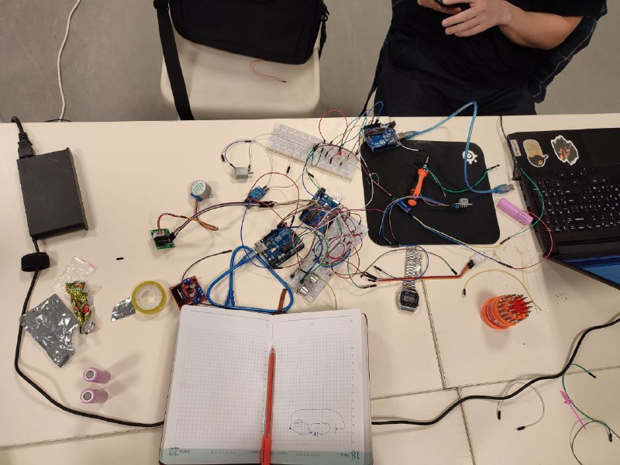
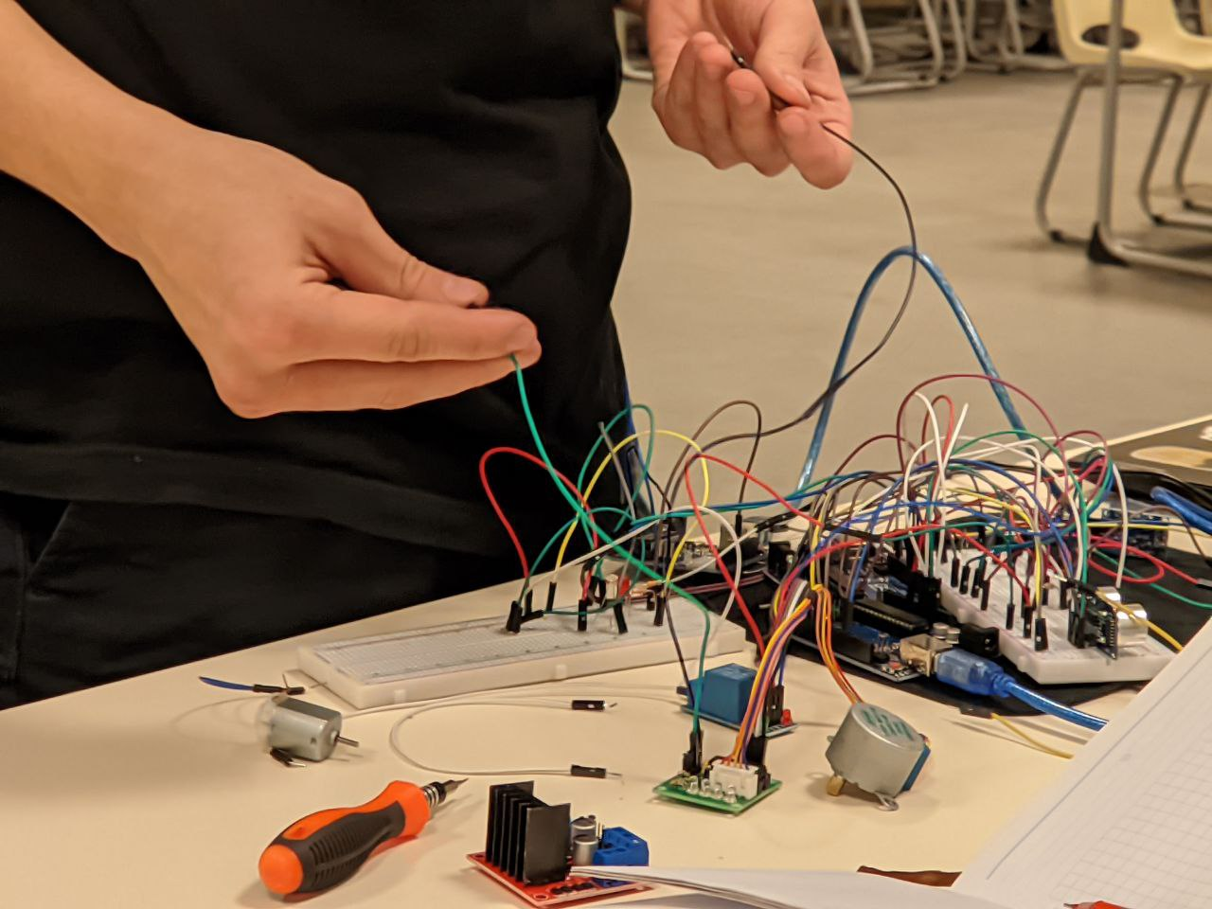
Visual Presentation of process:
The process of creating the circuits

Slide 9
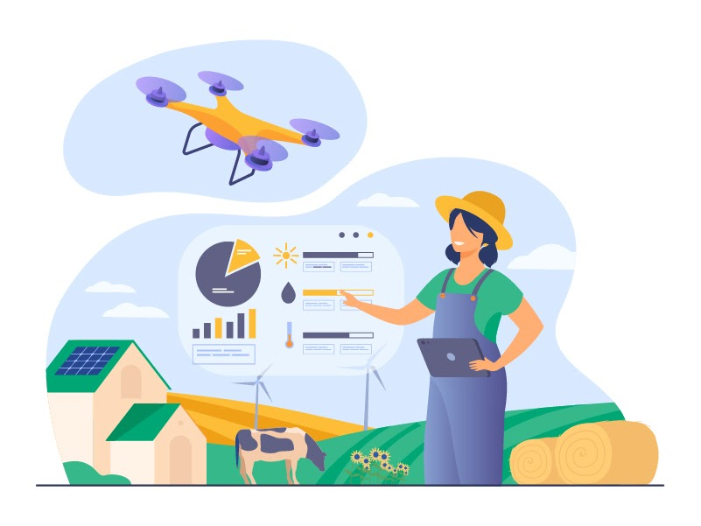
Conclusion:
Precision agriculture aims to enhance farming by incorporating connectivity and intelligence. This approach helps in decreasing overall expenses, improving the quality and quantity of products, promoting sustainable agriculture, and enhancing the customer experience. By having better control over production, precision agriculture aids in cost management and minimizing waste. The capability to identify irregularities in crop growth or livestock health eliminates the danger of reduced yields. Besides, automation leads to greater efficiency. By employing smart devices, various processes can be simultaneously initiated, and automated services can refine product quality and quantity by ensuring better control over production processes.

Slide 10


Thank you for your attention

